Slide 1
Model Deployment using streamlit
In easy steps

Slide 2
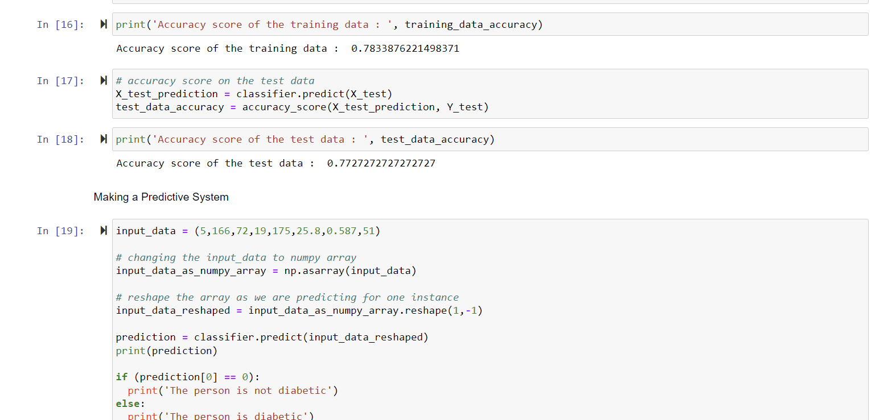
Open python Machine learning Algorithm file in IDE jupyter notebook or google colab or other

Slide 3
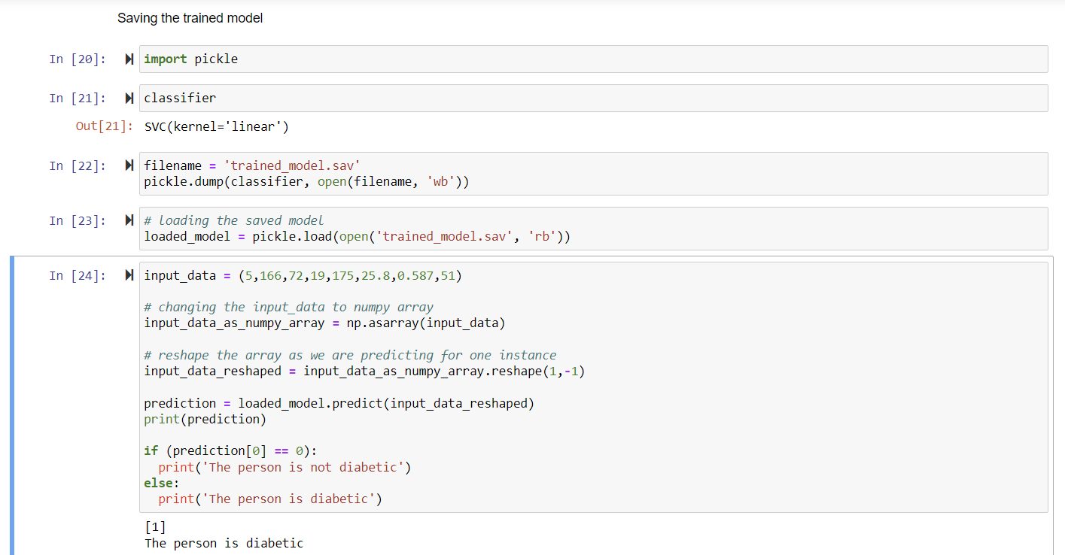
Write a code for saving trained model as .sav file using pickle

Slide 4
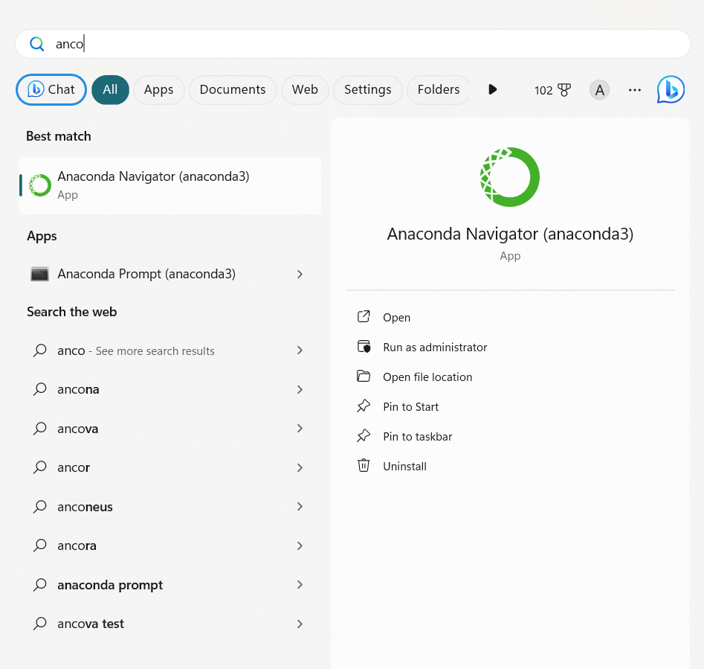
Open anaconda navigator

Slide 5
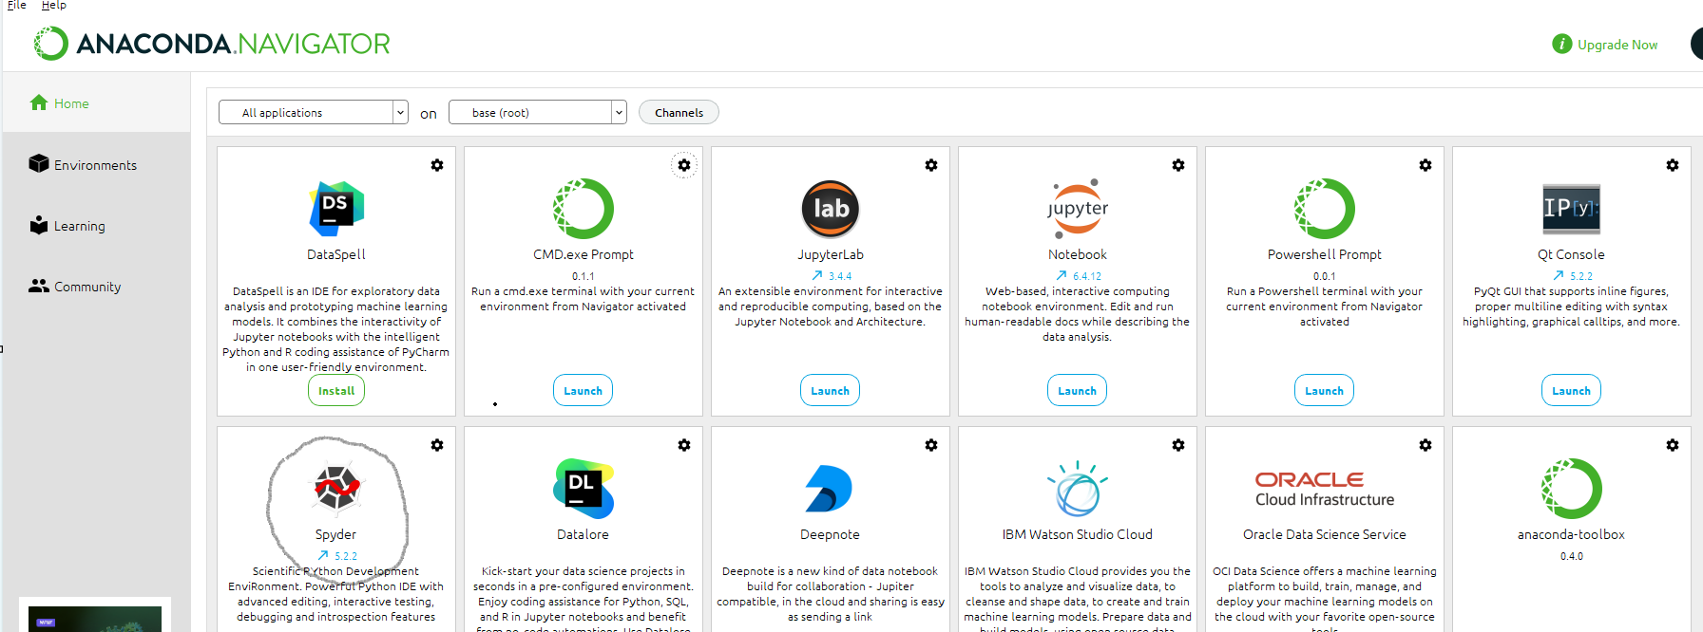
Now select spyder to launch spyder IDE
?

Slide 6
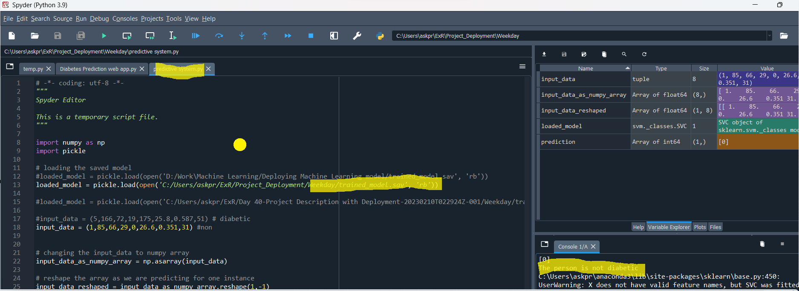
Write a code in spyder to read .sav file and pass parameters values to model to predict

Slide 7
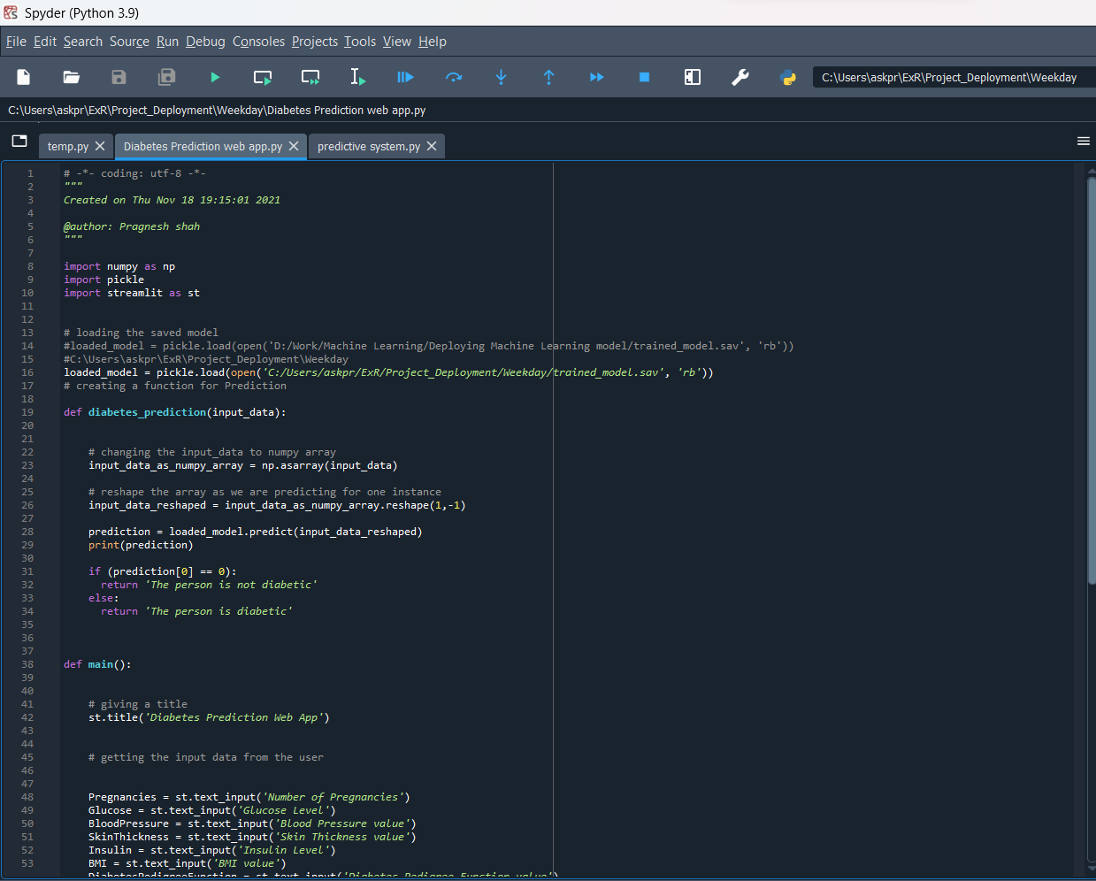
Create webapp.py file in spyder to take input from user in form of web UI and pass as a parameter to model to predict (Do not Run)

Slide 8
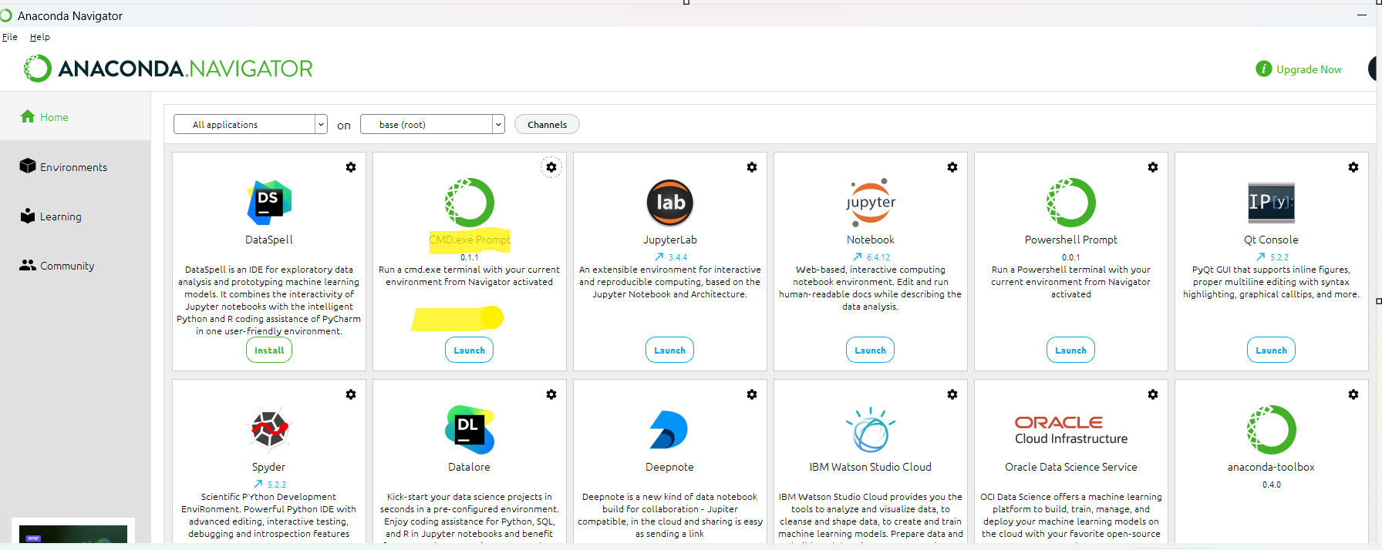
Now open cmd.exe prompt from Anaconda navigator or shell prompt

Slide 9
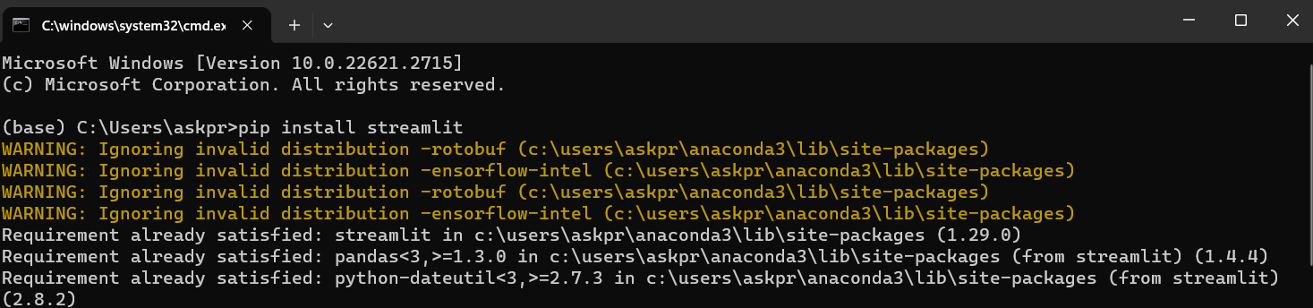
Install streamlit on anaconda prompt

Slide 10
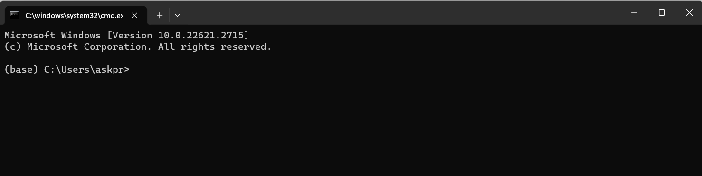
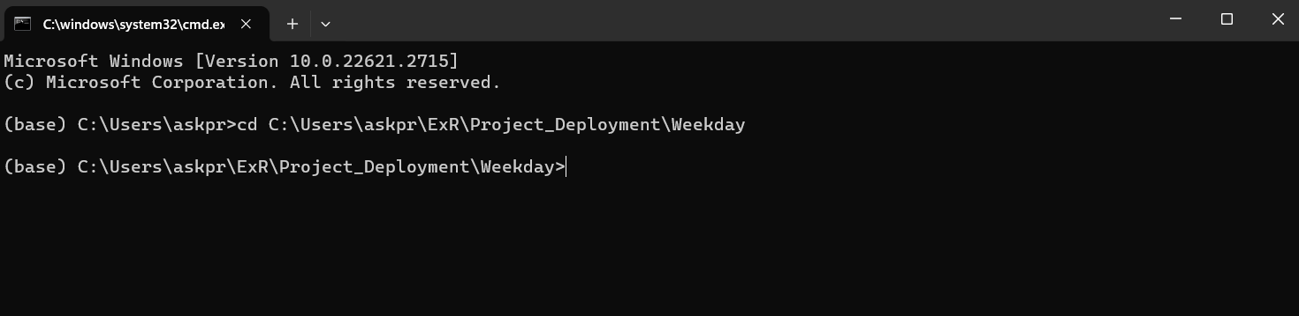
Now open cmd.exe prompt from Anaconda navigator or shell prompt
Now change current working directory to folder where python and model files are saved.

Slide 11
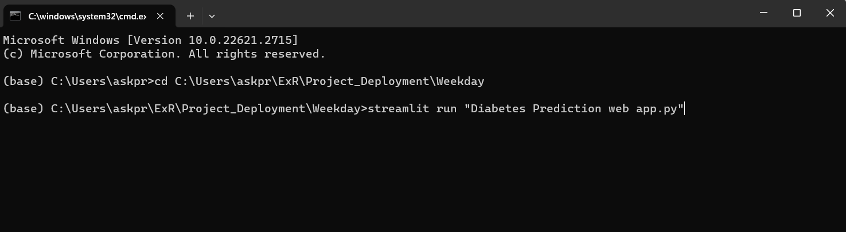
Now write command streamlit run <filename > to launch web file for python which open in browser

Slide 12
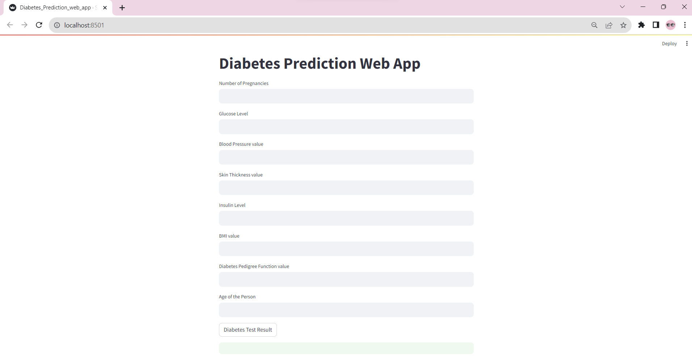
Browser opens in localhost: URL

Slide 13
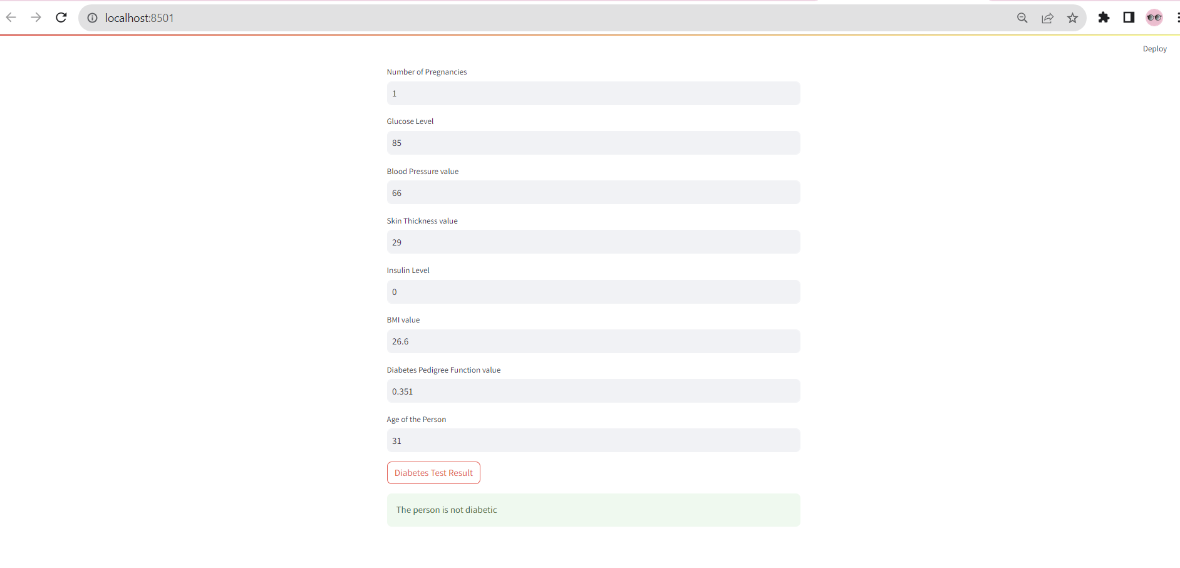
Enter values for patient to check Diabetic or not

Slide 14
Thank you

